Slide 1
Introduction to mRUBiS
Sona Ghahremani
sona.ghahremani@hpi.de
Notes:
https://en.wikipedia.org/wiki/Transduction_(machine_learning)

Slide 2

mRUBiS
mRUBiS is a marketplace modelled after eBay on which users sell or auction items
Derived from RUBiS (Rice University Bidding System), a popular case study to evaluate control theoretic algorithms
modularized RUBiS
A marketplace that hosts arbitrarily many shops
https://www.hpi.uni-potsdam.de/giese/public/mdelab/mdelab-projects/case-studies/mrubis/
Thomas Vogel. 2018. MRUBiS: an exemplar for model-based architectural self-healing and self-optimization. In Proceedings of the 13th International Conference on Software Engineering for Adaptive and Self-Managing Systems (SEAMS ’18). Association for Computing Machinery, New York, NY, USA, 101–107. DOI:https://doi.org/10.1145/3194133.3194161

Slide 3

Architecture of a single shop in mRUBiS
Each shop consists of 18 components and belongs to a tenant
All shops share the same component types but each shop has its own, individually configured components
Architecture of each shop is isolated from the architectures of the other shops (cf. multi-tenancy)
Multi-tenancy setting enables scaling up the system

Slide 4

mRUBiS as a Large Market Place

Slide 5


Architecture of the Market Place
A single controller controls all mRUBiS instances.
Controller

Slide 6
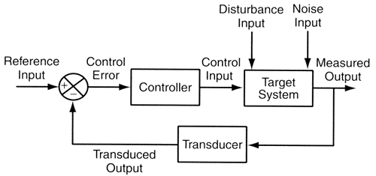
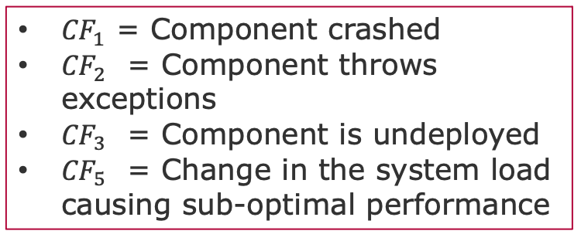
Disturabance in mRUBiS
${CF}_{1}$ = Component crashed
${CF}_{2}$ = Component throws exceptions
${CF}_{3}$ = Component is undeployed
${CF}_{5}$ = Change in the system load causing sub-optimal performance
mRUBiS

Slide 7

Failures and Affected Components
Controller
Affected Component
Affected Component Uid:
(_SEu7n-cdEeet0YmmfbMwkw )
Critical Failures
Affected Component :
(Shop#,Component_type)

Slide 8
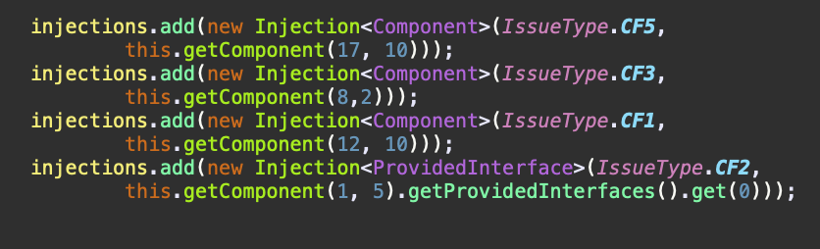
Input Failure Traces in mRUBiS
Affected Component
Controller
Affected Component Uid:
(_SEu7n-cdEeet0YmmfbMwkw )
Critical Failures
Affected Component :
(Shop#,Component_type)
Shop index
Affected Component index

Slide 9
Possible Observations (Outputs) in mRUBiS
Output 1: list of all components and their corresponding CF status (CF0 to CF5): <Shop_id, Component_type, CF_x>
Output 2: for each component, the current values of their parameters and the corresponding utility <Param_1,…,Param_N, Component_utility>
Output 3: the list of <Compoment_type, CF_x, Action, Cost>
Output 4: system current Overall Utility, Shop Utility or, Component Utility

Slide 10
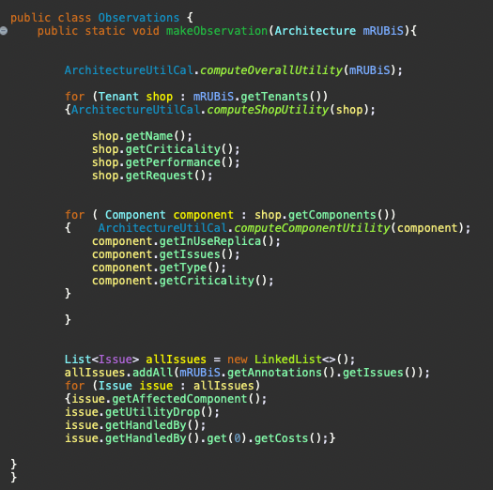
Instance of mRUBiS for Sampling
Output 1: list of all components and their corresponding CF status (CF0 to CF5): <Shop_id, Component_type, CF_x>
Output 2: for each component, the current values of their parameters and the corresponding utility <Param_1,…,Param_N, Component_utility>
Output 3: the list of <Compoment_type, CF_x, Action, cost>
Output 4: system current Overall Utility

Slide 11
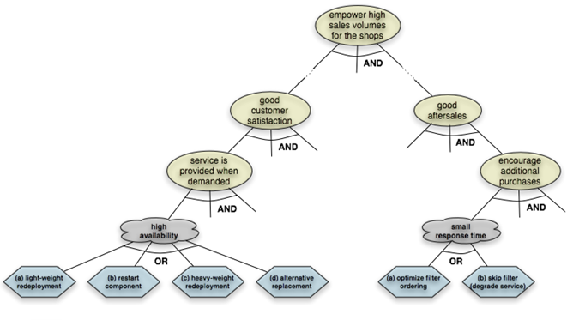
mRUBiS Goal Model
The controller follows a goal-based approach focused on fulfilling the soft goals of High availability and Low response time for the shops.
Disturbances are addressed via two sets of actions:
Repair Action
Optimization Actions

Slide 12
Possible Actions in mRUBiS
Repair Action
Restart Component
Heavy Weight Redeployment
Light weight Redeployment
Replace Component (if an alternative component is available)
Optimization Actions
Add Replica
Remove Replica

Slide 13
Mapping Actions to CFs
CF1,CF2,CF3 can be addressed by:
Restart Component
Heavy Weight Redeployment
Light Weight Redeployment
Replace Component (if an alternative component is available)
CF5 can be addressed by:
Add Replica
Remove Replica
Action: <Reward, Cost>
Reward (Affected_Component , CF_type)

Slide 14
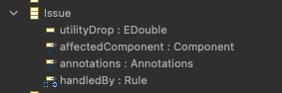
CFs (issues) in mRUBiS
For each CF_x
Affected Component
Component parameters can be observed!
Utility Drop
Possible Actions to Resolve
Action: <Reward, Cost>
Reward is the Utility Increase or Delta

Slide 15
Utility Drop
Utility
Utility (CF_{null})
CF3
Dropped U ₁
CF5
Dropped U ₂
CF1
Dropped U ₃
Time

Slide 16
Which Actions to Take? -→ You tell mRUBiS
Utility
Add Replica
Utility (CF_{null})
Restart
CF3
Dropped U ₁
Add Replica
Replace
CF5
HW Redeployment
LW Redeployment
Dropped U ₂
CF1
Dropped U ₃
Time

Slide 17
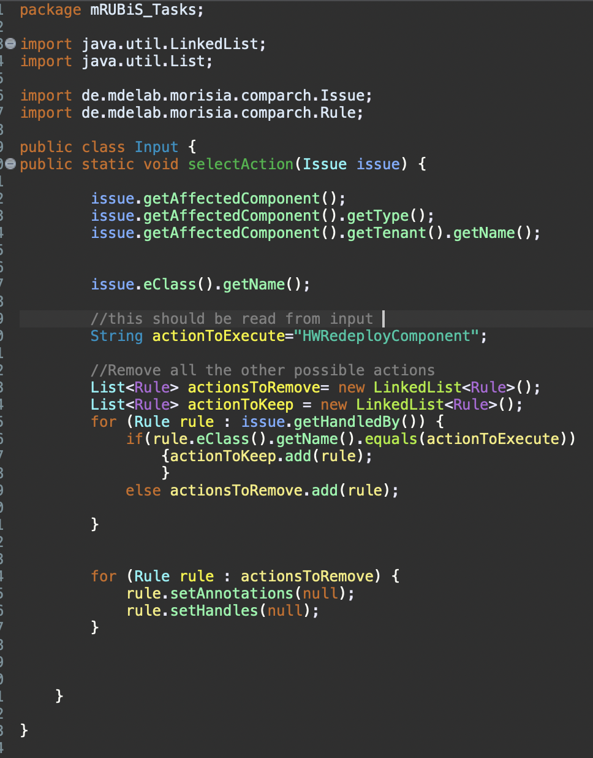
Which Actions to Take? -→ You tell mRUBiS

Slide 18
And in Which Order?
1-Heavy Weight Redeployment
2-Restart Component
3-Add Replica
Utility
Add Replica
Utility (CF_{null})
Restart
CF3
HW Redeployment
Dropped U ₁
Lost Utility Over Time
CF5
HW Redeployment
Restart
1- Add Replica
2-Restart Component
3- Heavy Weight Redeployment
Dropped U ₂
CF1
Add Replica
Dropped U ₃
Time

Slide 19
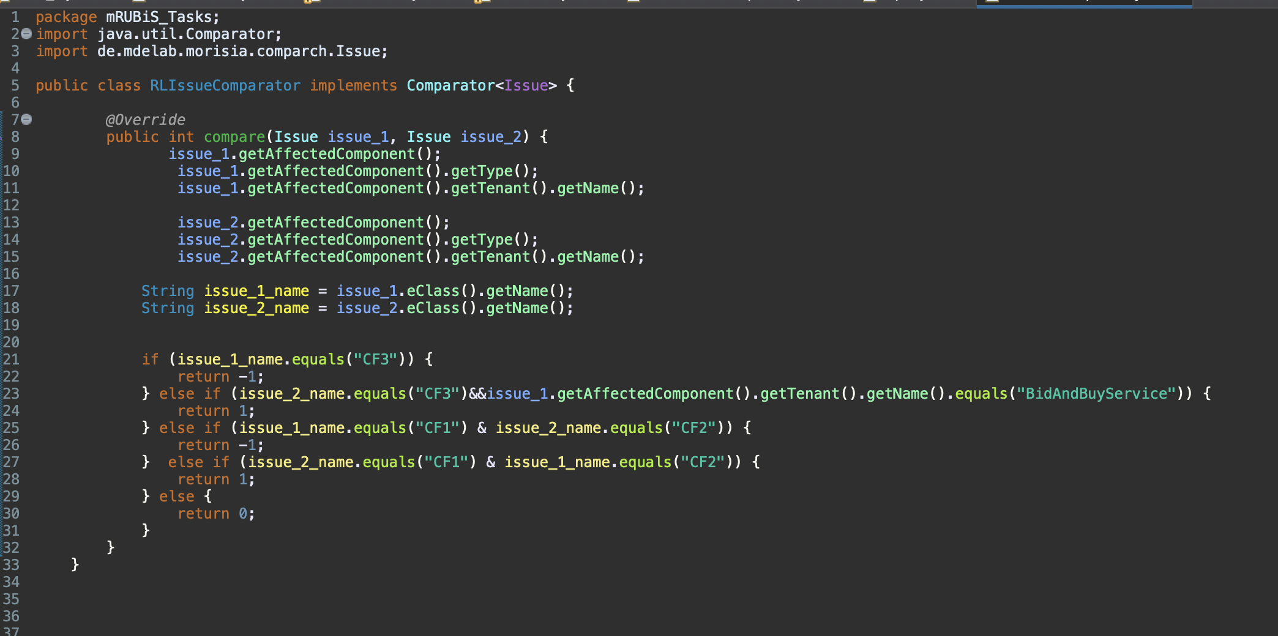
And in Which Order?
Input: ordered list of <component , action>
Or Input: ordered list of <component , CF_x>

Slide 20
Back-end
Thomas Vogel. 2018. mRUBiS: an exemplar for model-based architectural self-healing and self-optimization.
In Proceedings of the 13th International Conference on Software Engineering for Adaptive and Self-Managing Systems (SEAMS ’18).
Association for Computing Machinery, New York, NY, USA, 101–107. DOI:https://doi.org/10.1145/3194133.3194161

Slide 21

Eclipse Modeling Framework
The mRUBiS Simulator maintains a model of mRUBiS that simulates the real system.
This model is an instance of a metamodel developed with the Eclipse Modeling Framework (EMF).
Framework and code-generation tool for building Java applications based on models (model-driven development).
To use the simulator a Java installation and the Eclipse Modelling Tools edition of Eclipse Download here:
http://www.eclipse.org/downloads/packages/release/2021-03/r/eclipse-modeling-tools

Slide 22
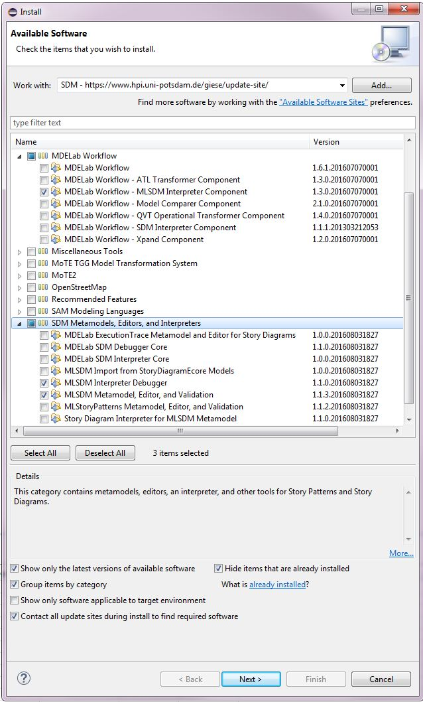
SDM
Download the Eclipse Modeling Tools package
Add the following update sites to the Eclipse update manager:
MDELab update site: https://www.hpi.uni-potsdam.de/giese/update-site/
Eclipse Neon update site: http://download.eclipse.org/releases/neon/ (this is because the latest Eclipse releases no longer include GMF (Graphical Modeling Framework), which is used by the SDM graphical editors).
Select the following features:

Slide 23
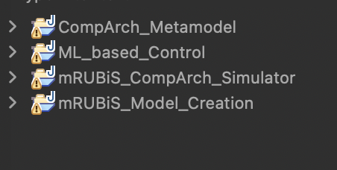
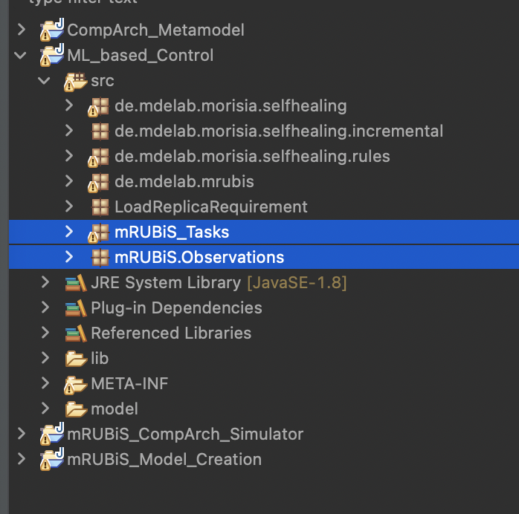
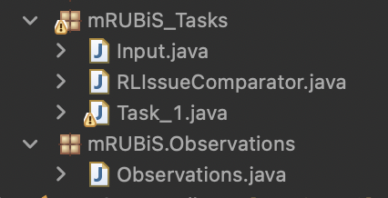
Project Files
Will be uploaded on GitHub

Slide 24
End

